Slide 1
Command Pattern
Han Ling & Nicholas Bezanis

Slide 2
The intent
Encapsulate a request as an object, thereby letting you parameterize clients with different requests, queue or log requests, and support undoable operations.
Basically, it’s what we type to the cmd or other compiler

Slide 3
Also we can call it
Action !
Transaction !

Slide 4
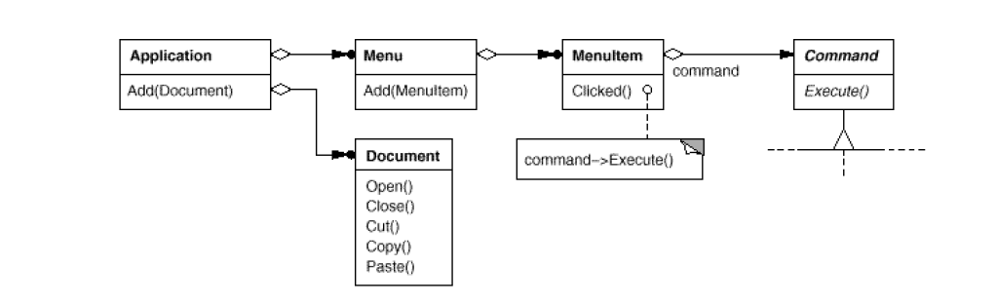
Motivation

Slide 5
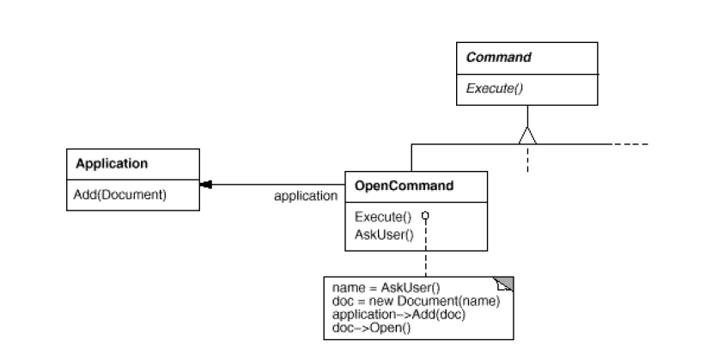
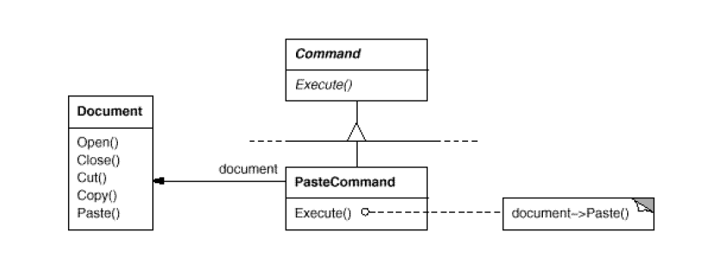
Motivation

Slide 6
Applicability
Commands are an object-oriented replacement for callbacks.
A Command object can have a lifetime independent of the original request.
Support undo.
Support logging changes so that they can be reapplied in case of a system crash.
structure a system around high-level operations built on primitives operations.

Slide 7
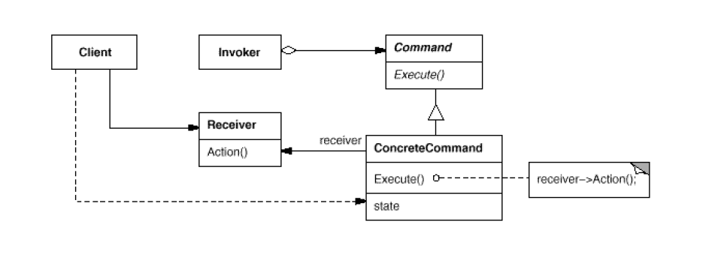
Structure

Slide 8
Collaborations
The client creates a ConcreteCommand object and specifies its receiver.
An Invoker object stores the ConcreteCommand object.
The invoker issues a request by calling Execute on the command. When commands are undoable, ConcreteCommand stores state for undoing the command prior to invoking Execute.
The ConcreteCommand object invokes operations on its receiver to carry out the request.

Slide 9
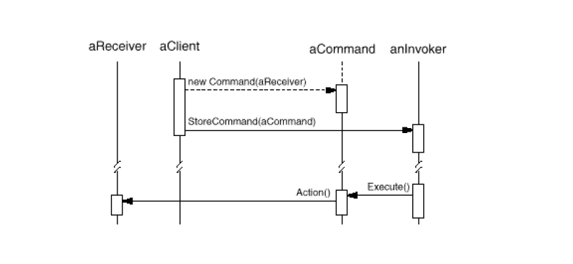

Slide 10
Consequences
Decouples the command object and the object performing the command
Commands can be extended
Multiple different commands can be combined into 1 command
New commands can be added without changing existing code

Slide 11
When you should use the Command pattern
You want an object oriented alternative to callback functions
If you want to queue, and execute requests at different times
If you need to undo requests
If you want to support logging changes
If you want to structure your system so that high level operations are built on primitive operations

Slide 12
When should you not use the Command pattern
If you have a small project that doesn’t require complex architecture

Slide 13
Implementation: Things to consider
How should the command interact with the receiver
Binds the receiver and the action
Doesn’t need a receiver
Finds receiver dynamically
How to support undo
How many levels of undo to support
How to avoid errors from undoing

Slide 14
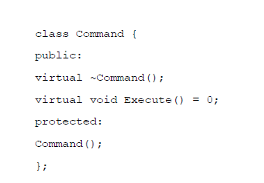
Example code:
The C++ code shown here sketches the implementation of the Command classes in the Motivation section. We'll define OpenCommand, PasteCommand, and MacroCommand.
First the abstract Command class:

Slide 15
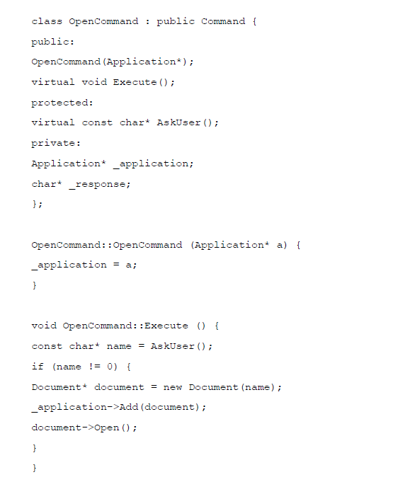
OpenCommand opens a document whose name is supplied by the user. An OpenCommand must be passed an Application object in its constructor. Ask User is an implementation routine that prompts the user for the name of the document to open.

Slide 16
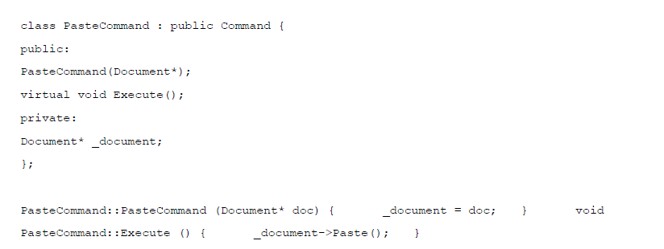
A PasteCommand must be passed a Document object as its receiver. The receiver is given as a parameter to PasteCommand's constructor.

Slide 17
Sources
Design Patterns Elements of Reusable Object-Oriented Software by Erich Gamma, Richard Helm, Ralph Johnson, John M. Vlissides
https://student.cs.uwaterloo.ca/~cs446/1171/Arch_Design_Activity/Command.pdf

